Slide 1

Urban Food
Access Analysis
Aditya Thakur
Amanpreet Kaur
Andrew Baer
Tanin Nazmul
Varinder Singh

Slide 2
Introduction
Review of the data analysis of Urban Census tracts in the state of Texas to determine the data objects that are connected to Food Deserts.
Food deserts are defined as parts of the country without accessible and affordable healthy and nutritious foods, essentially low income and low access areas.
The analysis identified various expected and unexpected results. Some of the expected results show that increasing the poverty rate and decreasing the median family income of a tract will increase the chance that the tract is a food desert.

Slide 3
Motivation and Background
Our analysis can help improve food access for more people. Food access aligns with our mutual desires to enact positive social change and this keeps us motivated.
Population growth in the United States is being driven by these very communities in need.
Our report is not only an opportunity to utilize and discuss our business analytics skill, but a call to action for our peers.

Slide 4
Data description
The data is a composite of 2010 Census and 2010-14 American Community Survey:
  The data was constructed to allow visibility into many factors that contribute to deserts, income, distance to grocery stores, and vehicle access.
  For the Census, counties are further subdivided into census tracts or just tracts.
  Poverty rate is the ratio of the number of people by age group, whose income falls below half the median income of the total populate.

Slide 5
Data Preparation
The following describes details on how data was prepared for the analysis:
  Only the data for Texas and urban environments is utilized to reduce the sample size.
  The indicators used for input represent income, housing status, and ethnic makeup of the tracts. These are farther divided into more specific indicators.

Slide 6
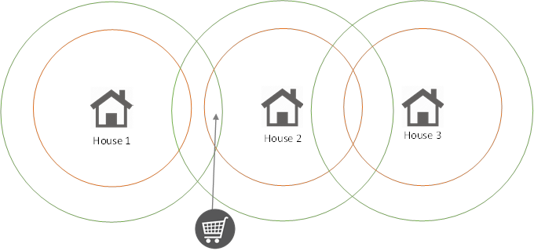
Consider this illustrated example:
House 3’ would be counted as both a half mile and one mile food dessert. The deserts are not independent and neither is their predictors given this relationship.
We purposefully choose one mile, because it is inclusive of half mile food deserts.
House | Half Mile Food Desert | One Mile Food Desert
1 | Y | N
2 | N | N
3 | Y | Y

Slide 7
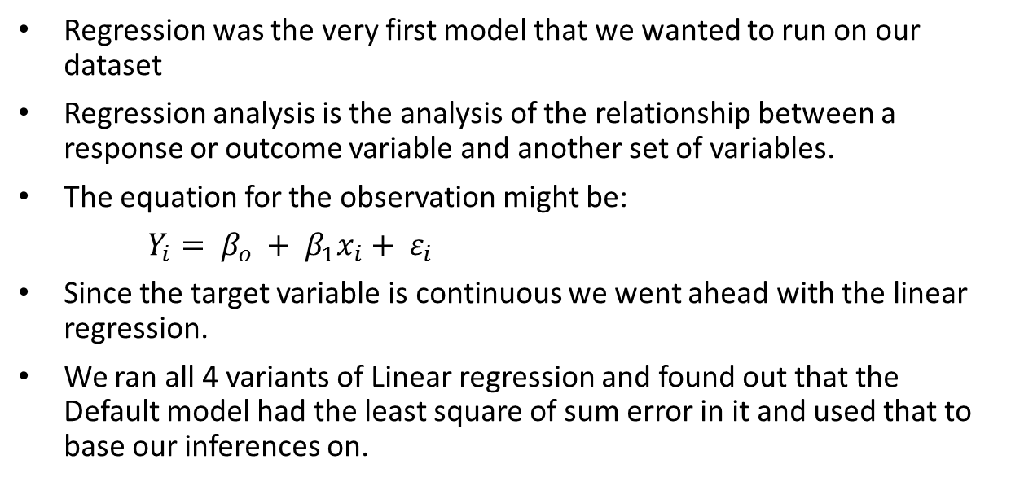
Linear Regression
Regression was the very first model that we wanted to run on our dataset
Regression analysis is the analysis of the relationship between a response or outcome variable and another set of variables.
The equation for the observation might be:
$Y_{i}= β_{o }+ β_{1}x_{i}+ ε_{i}$
Since the target variable is continuous we went ahead with the linear regression.
We ran all 4 variants of Linear regression and found out that the Default model had the least square of sum error in it and used that to base our inferences on.

Slide 8
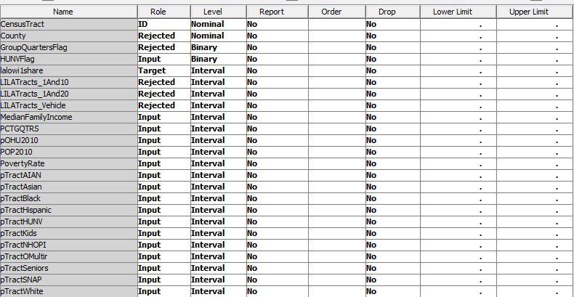
Variable selection

Slide 9
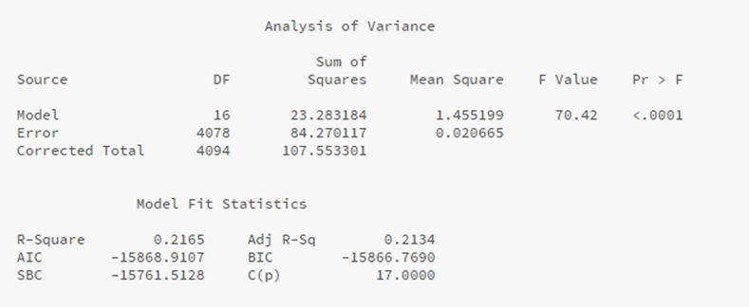
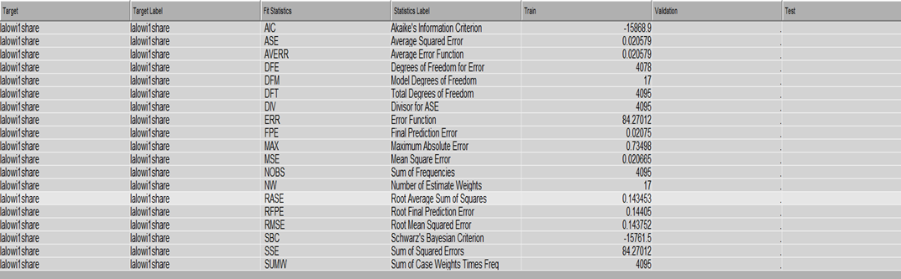
Linear Regression

Slide 10
Regression Inferences
Upon viewing the results, the F value was found to be very significant but this was not the case when it comes to the R square and the adj. R square
The F value was less than 1% whereas only 21% of the model could be explained by the regression
These were the significant variable that influenced the target variable the most
They consisted of HUNVFlag, MedianFamilyIncome, POP2010, PovertyRate, pOHU2010, ptractAIAN, ptractAsian, ptractBlack, pTractNHOPI, pTractSNAP, pTractSeniors, pTractOMultir and pTractWhite
The notable thing here is that apart from population tract of Hispanic and Kids most of the other variables were very significant

Slide 11
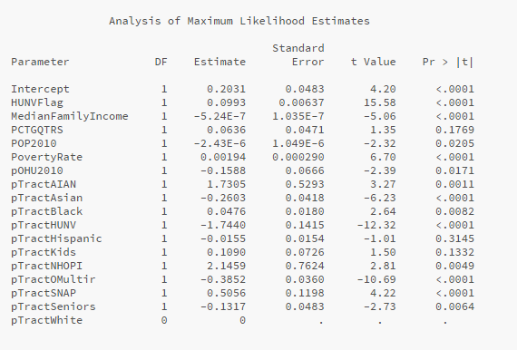

Slide 12
Significant variables
Field | LongName | Description
MedianFamilyIncome | Tract median family income | Tract median family income
POP2010 | Population, tract total | Population count from 2010 census
PovertyRate | Tract poverty rate | Share of the tract population living with income at or below the Federal poverty thresholds for family size
OHU2010 | Housing units, total | Occupied housing unit count from 2010 census
TractAIAN | Tract American Indian and Alaska Native population, number | Total count of American Indian and Alaska Native population in tract
TractAsian | Tract Asian population, number | Total count of Asian population in tract
TractBlack | Tract Black or African American population, number | Total count of Black or African American population in tract
TractNHOPI | Tract Native Hawaiian and Other Pacific Islander population, number | Total count of Native Hawaiian and Other Pacific Islander population in tract
TractSNAP | Tract housing units receiving SNAP benefits, number | Total count of housing units receiving SNAP benefits in tract
TractSeniors | Tract seniors age 65+, number | Total count of seniors age 65+ in tract
TractOMultir | Tract Other/Multiple race population, number | Total count of Other/Multiple race population in tract
TractWhite | Tract White population, number | Total count of White population in tract
lalowi1share | Low access, low-income population at 1 mile, share | Share of tract population that are low income individuals beyond 1 mile from supermarket

Slide 13
Cluster Analysis
The clustering data model has the ability to determine the similarity between a collection of data objects.
Unlike our Linear regression and Decision trees model, we didn’t have any target variable for our clustering model
In this dataset, clustering would be able to identify which variables are typically clustered together when speaking about food deserts.

Slide 14
Initial Cluster Analysis
Initially we had set the normalized data as the input for clustering but soon realized that Clustering node on SAS miner does this by default and hence we decided to proceed with the default data set
With automatic selection of clusters enabled, SAS identified 20 clusters, which also happens to be the default maximum, through its initial run within the dataset.
After another model was built with the new configuration, SAS identified 50 clusters, the new maximum amount allowed. The more clusters SAS was configured to identify, the more dissimilar the clusters became.

Slide 15
Through many trial and errors runs in the clustering model and analysis of subsequent Scree plots, 8 clusters were identified to best represent the population while maintaining valuable insight.
Segment ID (Pop Size) | Frequency of Cluster | Median Income | PCTG QTRS | Poverty Rate | Tract Asian | Tract Black | Tract White | Food Desert % | Name
1 (6571) | 23 | Medium | Low | Medium | Medium High | High | Middle | 25% | Average Income Food Desert
2 (2821) | 1178 | Medium | Low | Low | Medium Low | Medium Low | Middle | 11% | Sparse Tract with Plentiful Food
3 (5627) | 5 | Very Low | Low | Very High | Low | Medium Low | Middle | 31% | Very Poor Tract
4 (7686) | 542 | Medium | Low | Medium | Medium | Medium | Middle | 15% | Average Urban Texas Tract
5 (4661) | 49 | Medium | Very High | Medium | Medium | Medium | Middle | 20% | Group Quarters Segment
6 (14246) | 81 | High | Low | Very Low | Very High | High | High | 8% | Dense Wealthy Tracts
7 (5157) | 1220 | High | Low | Very Low | Medium High | Low | Middle | 5% | Sparse Wealthy Tracts
8 (4709) | 997 | Low | Low | Very High | Medium Low | Medium | Middle | 12% | Poor Tracts

Slide 16
Normalized Clustering
SAS Enterprise Miner returned a total of 6 clusters, all with varying frequencies. The frequencies ranged from 4-1986. There were 2 very large clusters (Segment 2 &3), 1 averaged sized cluster (Segment 5), and 3 small clusters (Segment 1, 4, & 6). Segment 1’s main deviation from the rest of the clusters was that it contained a high “PCTGQTRS” rating. This is the percentage of people living in group quarters in that census tract. Segment 1 scored a percentage of 67% of group quarters while all the other segments did not even reach 2%.
Segment 2’s main deviation from the rest of the clusters is the median family income. Segment 2 averaged a median family income of over $90,000, while the next highest was $48,000. Segment 2 additionally also contained the highest average white census tract at 76% white. Segment 3 contains very similar basic demographics as segment 2, except with a significantly lower median family income.
Segment 4 only contained a segment of 4 census tracts, and it’s main deviation was that it was very high in the Asian tract, 13%, with the next highest being 6%. Segment 5 contained the same income and poverty rate as segment 3, except its main demographic was black. Over 50% of this segment’s population was black compared to the next highest of 20%. Segment 6 only contained 6 census tracts, with the main similarity between those tracts being that it is a poor urban tract.

Slide 17
Cluster Analysis Using Normalized Data Set
SAS Enterprise Miner returned a total of 6 clusters, all with varying frequencies.
Segment ID | Frequency of Cluster | Median Income | PCTG QTRS | Poverty Rate | Tract Asian | Tract Black | Tract White | Food Desert % | Name
1 | 55 | Medium | High | Middle | Middle | Middle | Middle | 20% | Group Quarters Segment Desert
2 | 1986 | High | Low | Low | Middle | Low | Very High | 7% | Wealthy White Tract
3 | 1531 | Medium | Low | High | Low | Low | High | 14% | White Food Desert
4 | 4 | Medium Low | Low | Middle | High | Low | Middle | 16% | Asian Food Deserts
5 | 513 | Medium Low | Low | High | Low | Very High | Low | 16% | Black Food Deserts
6 | 6 | Low | Low | High | Low | Low | Middle | 25% | Poor Food Desert
The normalized dataset showed more of dissimilarity within the ethnicities of the regions than what the initial cluster analysis showed. This could be since the values were normalized; it was easier to tell if the proportions were different.

Slide 18
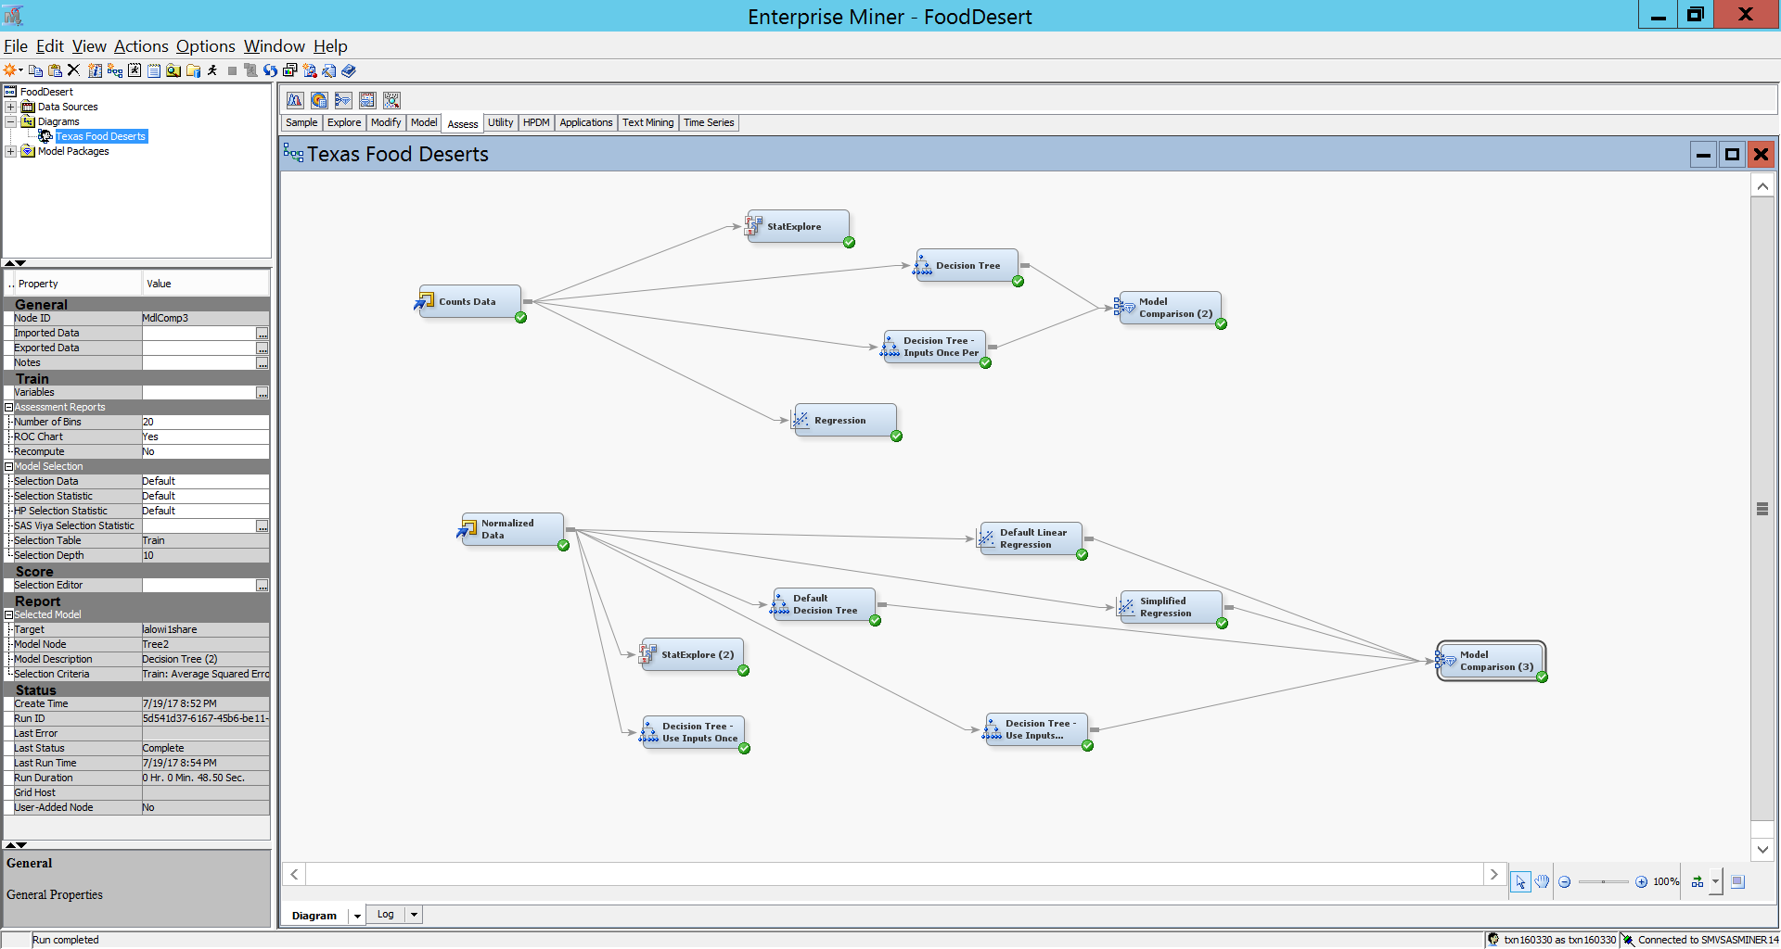
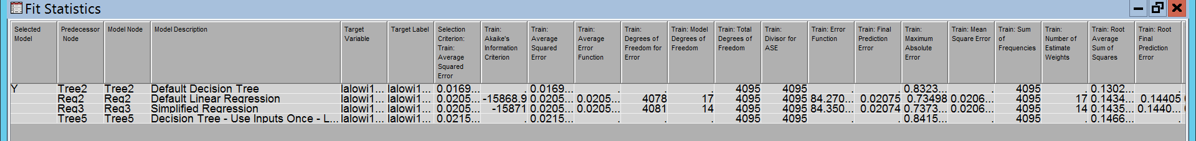
Model Comparison
We ran the model comparison node to compare the regression and decision tree models. After the analysis we determined that the default decision trees node had the smallest average squared error.
Shown below is the Fit Statistics view for the model comparison node. The default decision tree node had an average squared error of .0169, while the next highest was .0205.

Slide 19
Conclusion
Based on our findings:
  Approximately 17% of the Urban Texas population resides in a food desert.
  It has been proven that the relationship between health, learning, and nutrition is very strongly correlated
  Additionally, by identifying which areas of urban tracts are food deserts, city and county officials would have the ability to incentivize grocery stores in certain key areas to reduce the overall risks of food deserts

Slide 20
Conclusion

